Slide 1

Stroke Prediction Using Logistic Regression
FINAL YEAR PROJECT(18EC802)
Phase - 1
SHASHIDHAR GOWDA S(4MC18EC062)
SHREYAS B C (4MC18EC064)
SPOORTHI K R (4MC18EC070)
SWATHI H AIRANI (4MC18EC074)
Under the guidance of
Mrs. Swathi H Y,
Assistant Professor
Department of E & C Engg.
Malnad College Of Engineering, Hassan.

Slide 2
Contents
Introduction
Objective
Literature survey
Problem statement
Methodology
Flow chart
System Specification and Requirements
Implementation
Work done
Conclusion
References

Slide 3
Introduction
In today’s generation, impact of modern lifestyle is on our health. Young generation are more prone to stroke due to high blood pressure, smoking, diabetes, high blood cholesterol levels, heavy drinking, high salt and high fat diet and lack of exercise.
The project mainly aims at predicting the chances of occurrence of stroke using the emerging Machine Learning techniques. Aim is to create an application with a user-friendly interface which is easy to navigate and enter inputs.
Logistic Regression algorithm model would take the patients information and propose a bunch of suitable Expectation.

Slide 4
OBJECTIVE
The prime objective of this project is to construct a prediction model for predicting stroke using Logistic Regression algorithm.
According to the World Health Organization (WHO) stroke is the 2nd leading cause of death globally, responsible for approximately 11% of total deaths.
This model predicts whether a patient is likely to get stroke based on the input parameters like gender, age, Average Glucose level, BMI and smoking status.

Slide 5
Literature Survey
Sl.no | Author/s | Title of the paper | Description
1 | A.Sudha P.Gayatri N.Jaisankar | Effective analysis and predictive model of stroke disease using classification methods | Provides the Principle component analysis algorithm is used for reducing the dimensions and it determines the attributes involving more towards the prediction of stroke disease and predicts whether the patient is suffering from stroke disease or not.
2 | Elena Zamsa | Medical software user interfaces, stroke MD application design (IEEE) | Provides the design of an application interface for associated medical data visualization and management for neurologists in a stroke clustering and prediction system called Stroke MD.
3 | Min SN Park SJ Kim DJ Subramaniym M Lee KS | Development of an Algorithm for Stroke Prediction: A National Health Insurance Database Study | It provides a model equation for developing a stroke pre- diagnosis algorithm with the potentially modifiable risk factors.
4 | Philip A. Wolf Ralph B. D'Agostino Albert J.Belanger William B. Kannel | Probability of Stroke: A Risk Profile from the Framingham Study | A health risk appraisal function has been developed for the prediction of stroke using the Framingham Study cohort

Slide 6
Problem statement
Stroke is the second leading cause of death worldwide and remains an important health burden both for the individuals and for the national healthcare systems.
Potentially modifiable risk factors for stroke include hypertension, cardiac disease diabetes, and dysregulation of glucose metabolism, atrial fibrillation, and lifestyle factors.
Therefore, the goal of our project is to apply principles of machine learning over large existing data sets to effectively predict the stroke based on potentially modifiable risk factors.
Then it intended to develop the application to provide a personalized warning on the basis of each user’s level of stroke risk and a lifestyle correction message about the stroke risk factors.

Slide 7
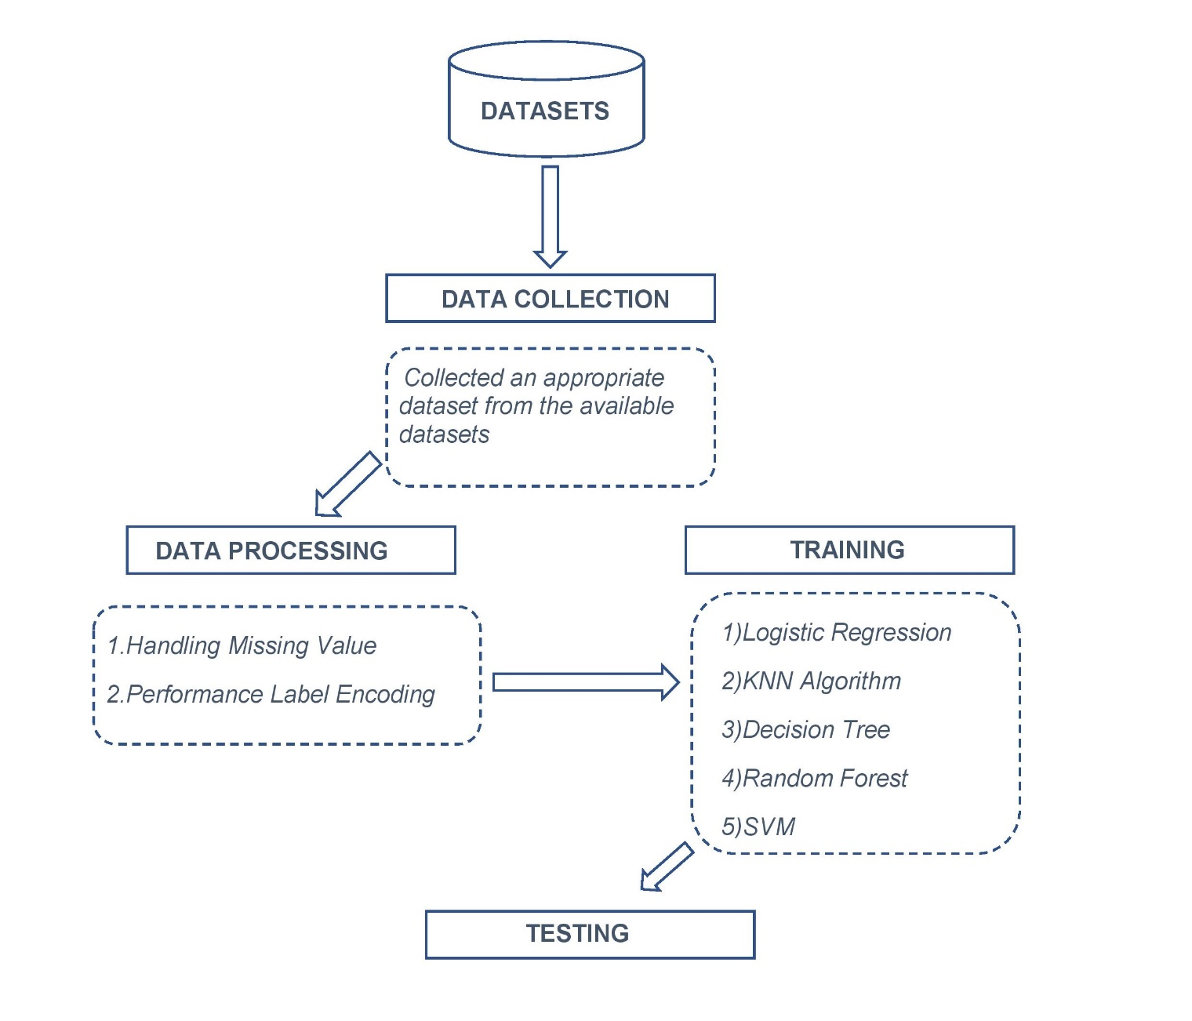
METHODOLOGY

Slide 8
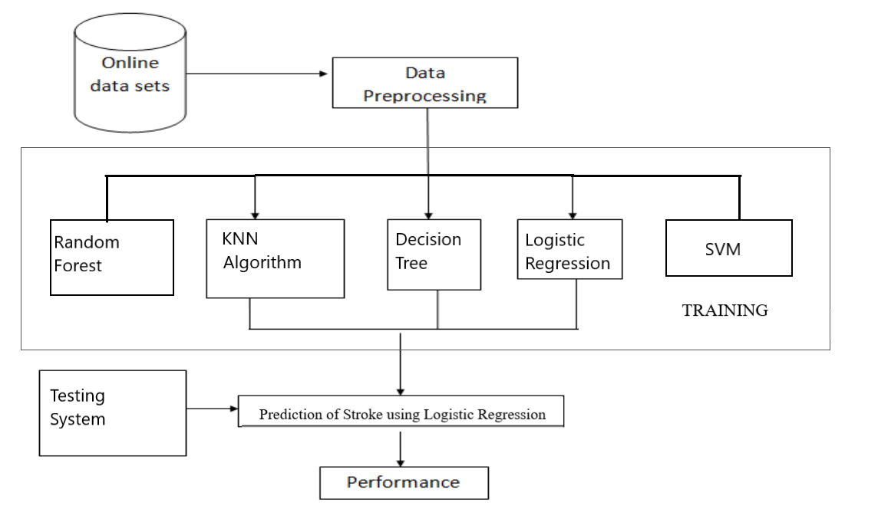
FLOW CHART
Training

Slide 9
SYSTEM SPECIFICATION AND REQUIREMENTS
a. Software Required
Different framework and libraries are included in specific requirements of a software system.
pandas
matplotlib.pyplot
scikit-Learn (Sklearn )
seaborn
pandas_profiling
Pickle
Operating System: Windows 10
Programming Language: Python
Code Editor: Anaconda Navigator(Jupyter)

Slide 10
b. Functional Requirements
The functional requirement of a system is:
• Python version 3.8.1 c.
c. Hardware Specifications
The following are the hardware requirements of a system:
• Processor: Intel Core i3 and higher.
• Speed: 2.30 GHz to 2.40 GHz.
• Install Memory (RAM): 4GB and higher.
• Hard Disk : 464 GB and above.
• System Type: 32-bit Operating System and higher.

Slide 11
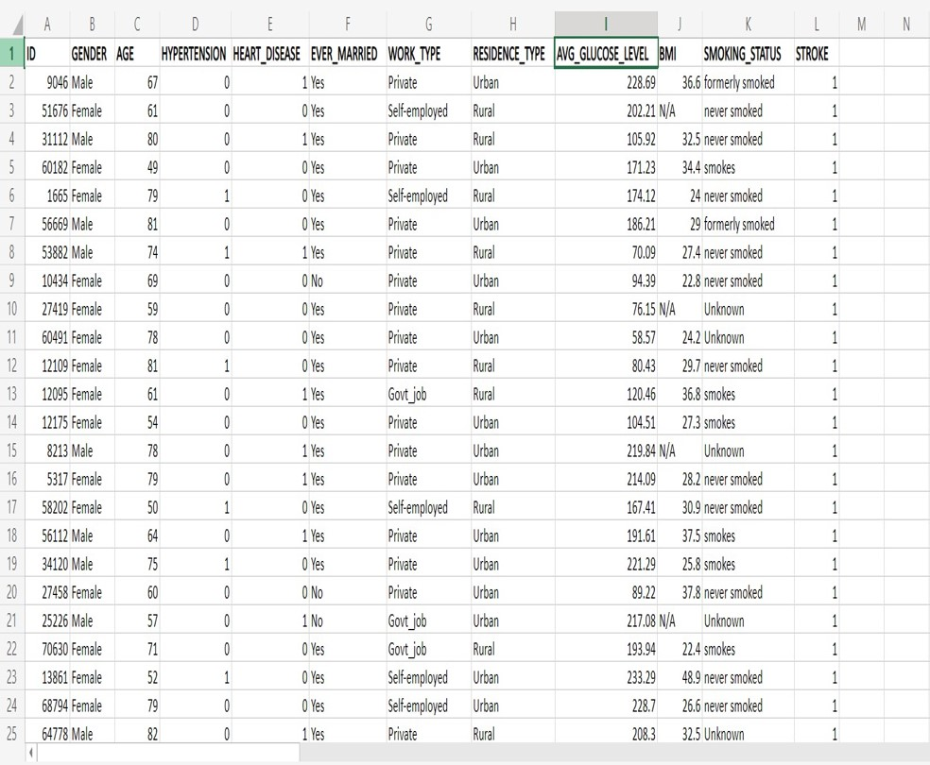
IMPLEMENTATION 1.Dataset

Slide 12
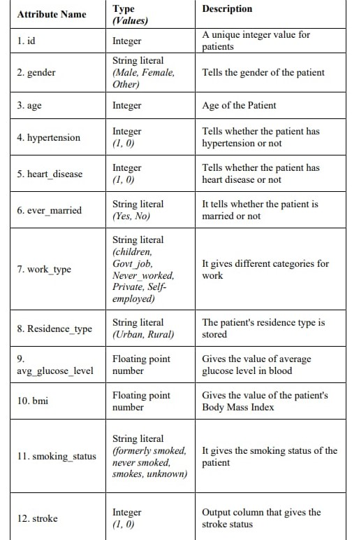

Slide 13
2.Data Preprocessing
The dataset taken has 12 attributes, as mentioned in Table. Firstly, the column 'id' is dropped because its existence does not make much difference in model building.
Then the dataset is checked for null values and filled if any found. In this case, the column 'bmi' has null values filled with the mean of the column data. After removing the null values from the dataset, the next task is Label Encoding.

Slide 14
3.Label encoding
Label encoding encodes the string literals in the dataset into integer values for the machine to understand them.
As the machine is usually trained in numbers, the strings have to be converted into integers.
There are five columns in the collected dataset that have strings as their data type.
On performing label encoding, all the strings get encoded, and the entire dataset becomes a combination of numerals.

Slide 15
We will convert string literals into numbers by using label encoder.
We will fit encoder to gender, smoking_status, work_type, residence_type, ever_married and transform.
The transformed data will be stored in respective variable that is gender, Smoking_status, work_type, residence_type, ever_married.
By giving data.info() input we get information about all the rows,columns and data types.

Slide 16
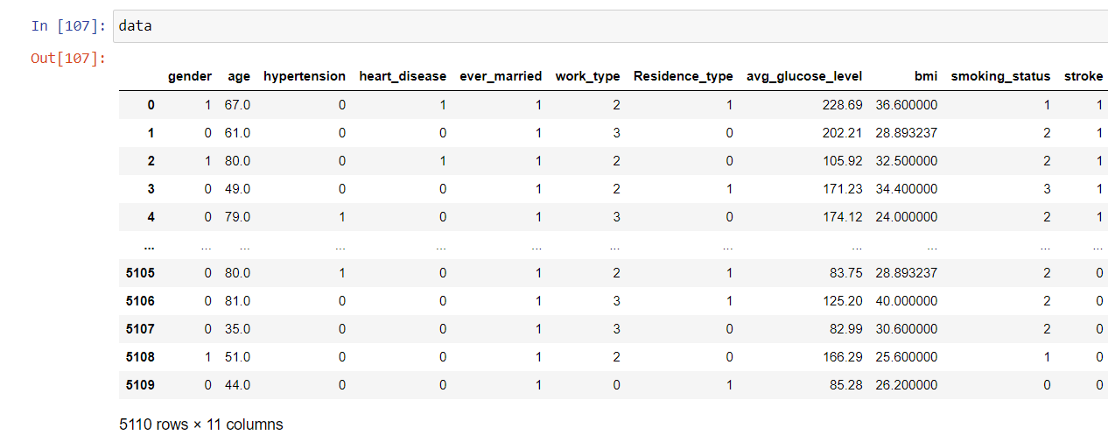

Slide 17
4.Splitting the data
After completing data preprocessing and handling the imbalanced dataset, the next step is building the model.
The under-sampled data is split into training and testing data for better accuracy .
After splitting, various classification algorithms are used to train the model.
The classification algorithms used for this purpose are Logistic Regression, K-Nearest Neighbors Classification.

Slide 18
We will split the dataset into training and testing data.
We used 80% of the dataset into training and 20% of the dataset into testing
We use data.drop input to remove particular column from the dataset.
We will train the datasets by using inputs x_train ,y_train.
Testing of the datasets will be done using x_test,y_test.

Slide 19
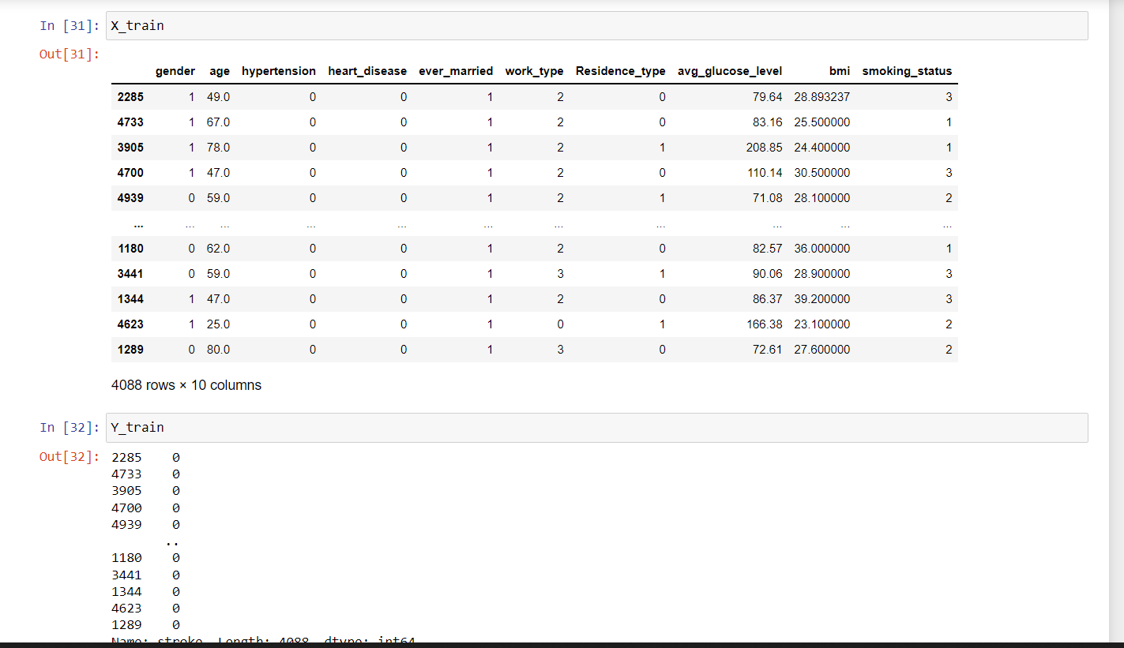

Slide 20
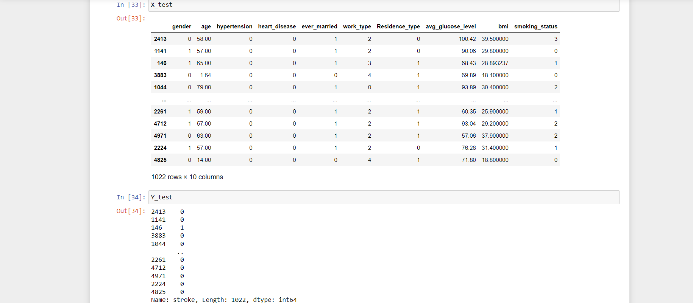

Slide 21
5.Classification Algorithms Logistic regression
Logistic Regression is a supervised learning algorithm used for predicting the probability of the output variable.
This algorithm is the best fit when the output variable has binary values (0 or 1).
As the output attribute in the dataset has only two possible values.

Slide 22
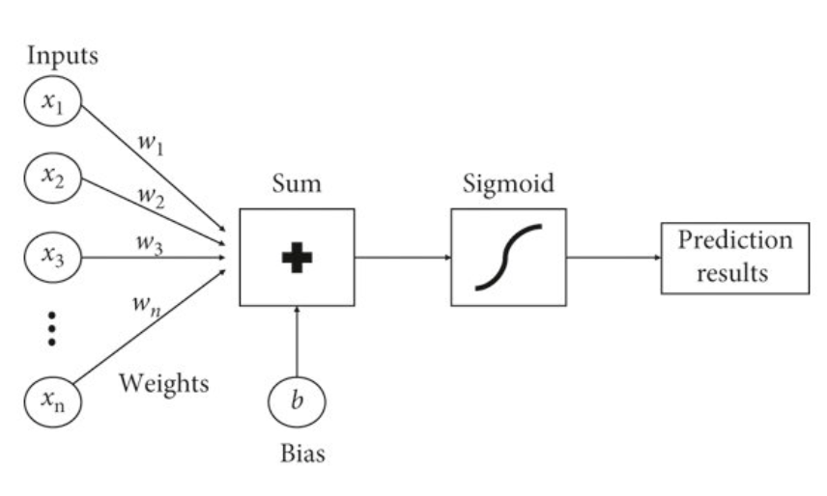
Logistic regression flowchart

Slide 23
KNN ALGORITHM
K-nearest neighbors classification: Another algorithm used for classification is K-Nearest Neighbors (KNN).
It is also a supervised learning technique. It stores the dataset, and at the time of classification, it acts on the dataset.
The working principle of KNN is to find similarities between the new case (or data) and available data and then map the new case into the category that is most similar to the available categories.

Slide 24
Random forest classification
Random Forests are composed of multiple independent decision trees trained independently on a random subset of data.
These trees are generated at the time of training, and the outputs are obtained from each decision tree.
For the final prediction from this algorithm, a method called "voting" takes place. This method means that each decision tree votes for an output class (in this case, the two classes are: 'stroke' and 'no stroke').
The random forest chooses the class with the maximum number of votes as the final prediction.

Slide 25
Support vector machine:
It is a supervised learning technique that can be associated with learning algorithms to analyze the data for both classification and regression.
Support Vector Machine (SVM) scales relatively well to high dimensional data.
SVM chooses the extreme points/vectors that help in creating the hyperplane. These extreme cases are called as support vectors.

Slide 26
Decision Tree Classification
Decision Tree classification is to solve both Regression and classification problems.
This algorithm is a supervised learning method wherein the input variables already have their corresponding output variable.
It is a tree-like structure. In this algorithm, the data continuously splits according to a particular parameter. A decision tree has two parts: Decision Node and Leaf node.
The data splits at the former node, and the latter is the node that gives the outcome.

Slide 27
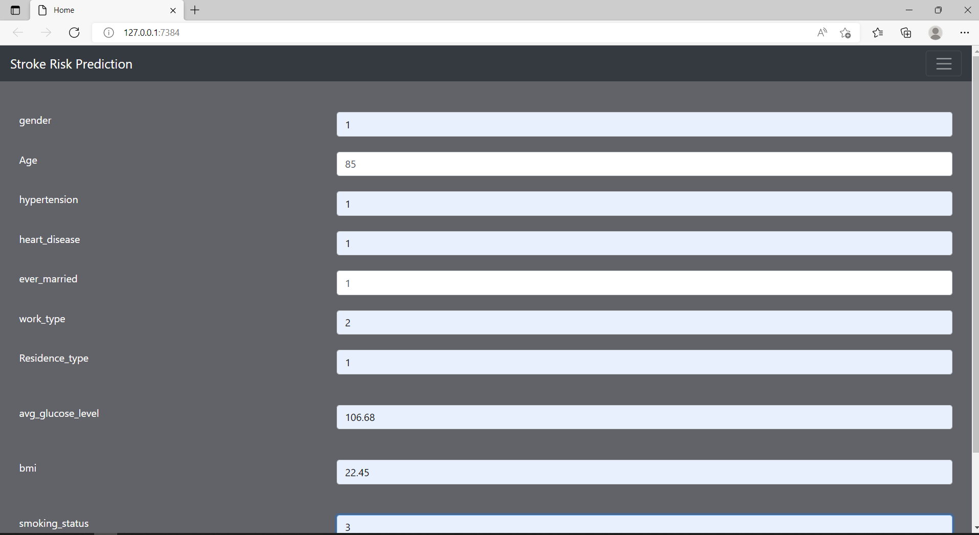

Slide 28
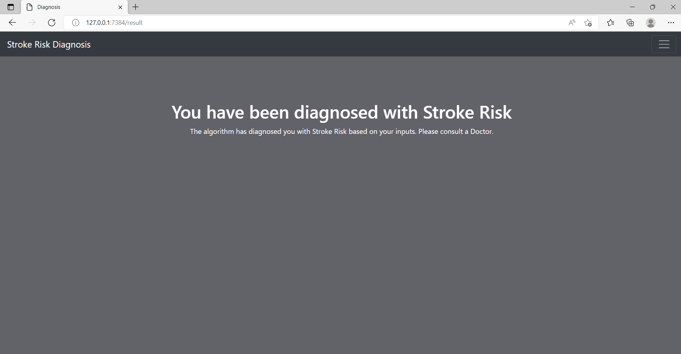

Slide 29
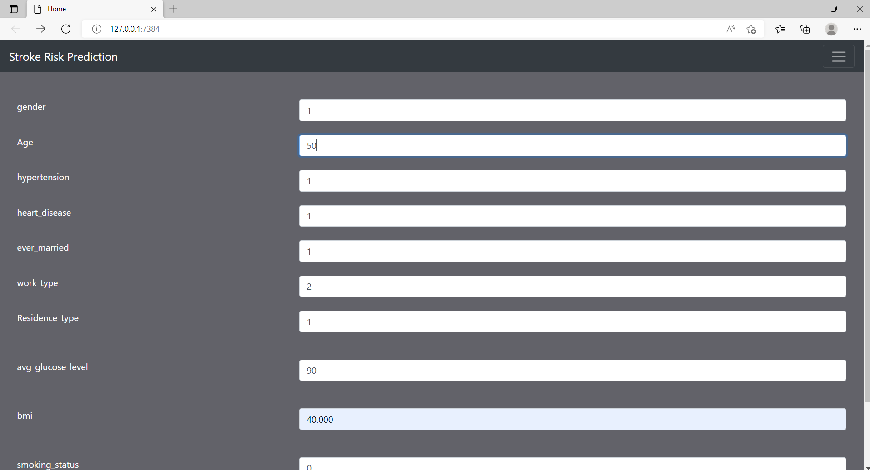

Slide 30


Slide 31
Work done
Collecting the data sets
After collecting the data sets, collect an appropriate dataset from the available dataset like gender, age, Average Glucose level, hypertension, heart disease, BMI and smoking status.
Data preprocessing
Split the data into training and testing
The data is trained using Logistic Regression algorithm and Logistic regression
Predicted data with respect to each model
Found accuracy, precision, recall, f-measure

Slide 32
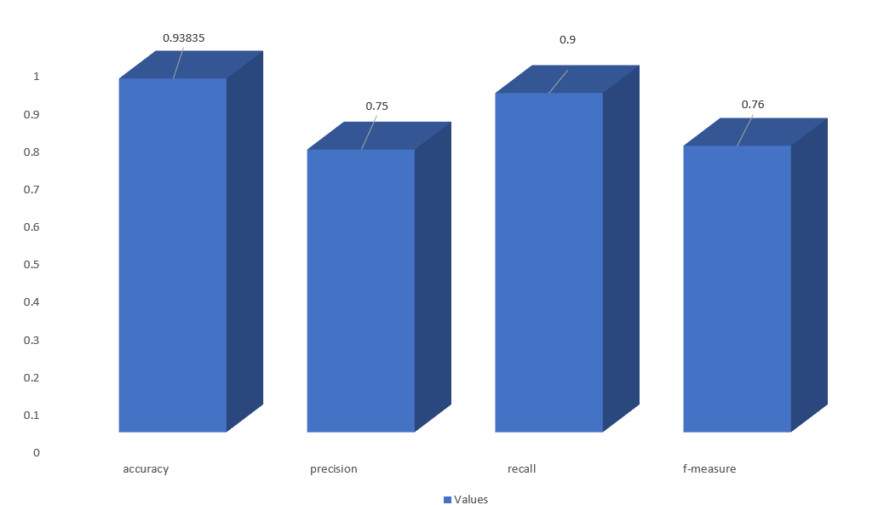
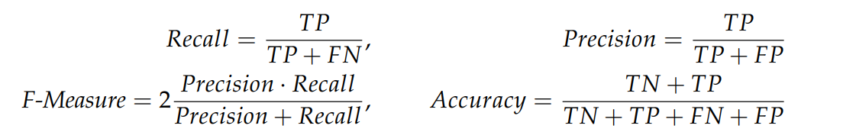
Conclusion:

Slide 33
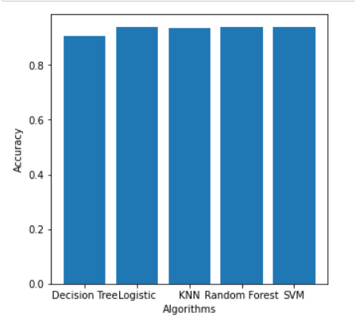
Stroke is a critical medical condition that should be treated before it worsens. Building a machine learning model can help in the early prediction of stroke and reduce the severe impact of the future.
The performance of various machine learning algorithms in successfully predicting stroke based on multiple physiological attributes.
Out of all the algorithms chosen, Logistic regression algorithm performs best with an accuracy of 93.835% , precision of 75%, recall of 90%, f-measure of 76%

Slide 34
REFERENCES
[1] S. Cheon, J. Kim, and J. Lim, “The use of deep learning to predict stroke patient mortality,” International Journal of Environmental Research and Public Health, vol. 16, no. 11, 2019.View at: Publisher Site | Google Scholar
[2] M. S. Zulfiker, N. Kabir, A. A. Biswas, P. Chakraborty, and M. M. Rahman, “Predicting students’ performance of the private universities of Bangladesh using machine learning approaches,” International Journal of Advanced Computer Science and Applications, vol. 11, no. 3, 2020.View at: Publisher Site | Google Scholar
[3] Tasfia Ismail Shoily, Tajul Islam, , Sumaiya Jannat and Sharmin Akter Tanna "Detection of stroke using machine learning algorithms", 10th International Conference on Computing, Communication and Networking Technologies (ICCCNT), IEEE, July 2019
[4] JoonNyung Heo , Jihoon G. Yoon , Hyungjong Park , Young Dae Kim , Hyo Suk Nam and Ji Hoe Heo. "Stroke prediction in acute stroke", Stroke. 2019;50:1263-1265, AHA Journal, 20 Mar 2019.
[5] Lin, C.-H., Hsu, K.-C., Johnson, K. R., Fann, Y. C., Tsai, C.-H., Sun, Y., et al. (2020). Evaluation of Machine Learning Methods to Stroke Outcome Prediction Using a Nationwide Disease Registry. Comp. Methods Programs Biomed. 190, 105381. doi:10.1016/j.cmpb.2020.105381
[6] Ge, Y., Wang, Q., Wang, L., Wu, H., Peng, C., Wang, J., et al. (2019). Predicting post-stroke Pneumonia Using Deep Neural Network Approaches. Int. J. Med. Inform. 132, 103986. doi:10.1016/j.ijmedinf.2019.103986

Slide 35
THANK YOU

